Slide 1

DATA

Slide 2
Sources
Source | Data
U.S. Department of Transportation, Bureau of Transportation Statistics | Flights originating from LAX, 2020-2024
Federal Aviation Administration (FAA) | Aircraft specifications by tail number
National Oceanic and Atmospheric Administration, National Weather Service | Historical weather observations for origin (LAX) and destination airports

Slide 3
Cleaning
Removed columns that contained a single value overwhelmingly (>99.9%)
Condensed categorical columns
Low value counts merged into ‘Other’.
Synonymous categories combined
For example: Airbus and Airbus SAS
Converted date and time columns into cyclical format (sin, cos) to facilitate machine learning
Verified no nulls remained

Slide 4
Target Variables
Investigated 3 options:
6 classes (semi-arbitrary)
4 classes based on FAA designations
Binary class based on FAA designations
Due to model performance, settled on binary classification:
Delayed if departure >15 minutes after schedule
Not delayed otherwise

Slide 5

MODELS

Slide 6
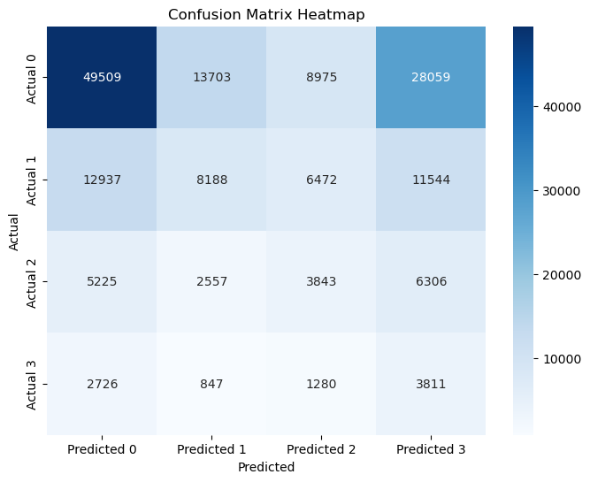
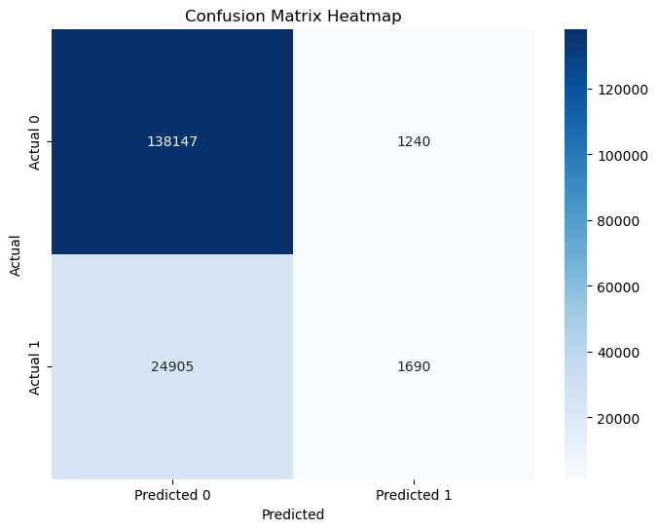
Random Forest
Multiclass (4 classes)
Binary Classification
 | Multiclass | Binary Classification | Binary w/ HyperParams
Training Accuracy | 0.3938 | 0.9999
Testing Accuracy | 0.3937 | 0.8424

Slide 7
Random Forest
Accuracy results for binary classification:
Configuration | Training Accuracy | Test Accuracy
Full forest | 0.9999 | 0.8424
Random Search Hyperparameters | 0.5937 | 0.5968
Additional hyperparameters overcorrected overfitting into underfitting.

Slide 8
Random Forest
Binary Classification, full tree
Label | Precision | Recall | F1
0 | 0.85 | 0.99 | 0.91
1 | 0.36 | 0.06 | 0.11
Accuracy |  |  | 0.84
Label
0
1
Accuracy
Binary Classification, hyperparameters determined by RandomSearchCV
Label | Precision | Recall | F1
0 | 0.88 | 0.59 | 0.71
1 | 0.22 | 0.60 | 0.32
Accuracy |  |  | 0.59
Label
0
1
Accuracy

Slide 9
Random Forest
Top features

Slide 10

Support Vector Classification
Model did not complete
Run time over 20 hours

Slide 11
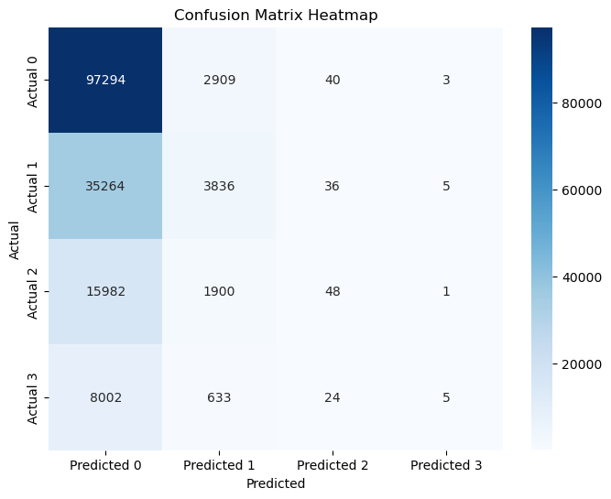

Logistic Regression
Multiclass (4 classes)
Binary Classification
 | Multiclass | Binary Classification
Training Accuracy | 0.6105 | 0.8397
Testing Accuracy | 0.6096 | 0.8397

Slide 12
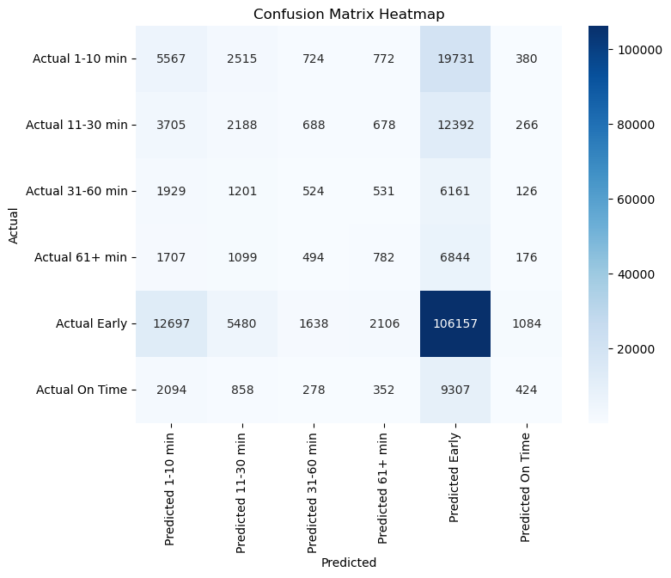
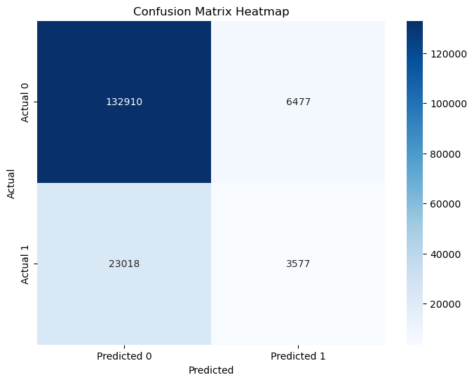
K-Nearest Neighbors
Multiclass (6 classes)
Binary Classification
 | Multiclass | Binary Classification
Training Accuracy | 0.6613 | 0.8619
Testing Accuracy | 0.5412 | 0.8223

Slide 13
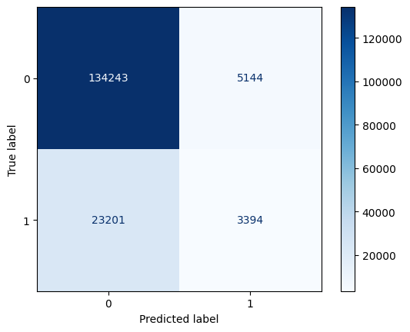
Neural Network
Binary Classification
Label | Precision | Recall | F1
0 | 0.85 | 0.96 | 0.90
1 | 0.40 | 0.13 | 0.19
Accuracy |  |  | 0.83
 | Binary Classification
Training Accuracy | 0.8516
Testing Accuracy | 0.8292

